Slide 1
COVID-19 Dataset: Predicting High and Low-Risk Patients
By Jan Owczarek

Slide 2
Content
Problem Statement
Purpose of Project (I & II)
Evaluating Model Performance
Data Exploration (I&II)
Data Processing (I & II)
Modelling (I, II, II & IV)
Conclusion
Limitations

Slide 3
Problem Statement
Severe acute respiratory system coronavirus 2 (SARS-CoV2 or COVID) has caused a global pandemic straining healthcare resources in countries all over the world.
Research institutions rushed to create a safe and effective vaccine to solve the global pandemic.
Being able to predict whether a COVID patient had a high or low risk of dying would drastically improve resource management.
Notes:
1) In turn, this caused a huge economic strain. At the time COVID was a very new and unknown virus and as such there was no vaccine for it. Research institutions were rushing to create a vaccine that is safe and could mitigate the drastic effects that the virus had on the world

Slide 4
Purpose of Project I
The purpose of this project is to predict high and low-risk COVID patients using various medical characteristics.
Viruses constantly mutate and new viruses may emerge.
Viruses that affect the respiratory system work in similar ways, creating a model would be beneficial for the future.

Slide 5
Purpose of Project II
Create a model that is confident in predicting whether a patient is high-risk. Focusing on reducing the false positive rate.
When we are confident in the high-risk prediction, we would minimise cases where valuable medical resources are used on low-risk patients.
The caveat here is that the model would be neglecting patients that are incorrectly classified as low-risk; not providing them with the appropriate care.

Slide 6


Evaluating Model Performance
Precision increases as the false positive rate decreases.
$$Precision=\frac{TP}{(TP+FP)}$$
To reduce the negligence of the low-risk class the F1-score will also be considered.
$$F1−score=2∗\frac{Precision∗Recall}{(Precision+Recall)}$$
Aim to increase precision as much as possible whilst maintaining F1-score above 0.75.
Notes:
Interpreting F1-score: https://stephenallwright.com/interpret-f1-score/

Slide 7
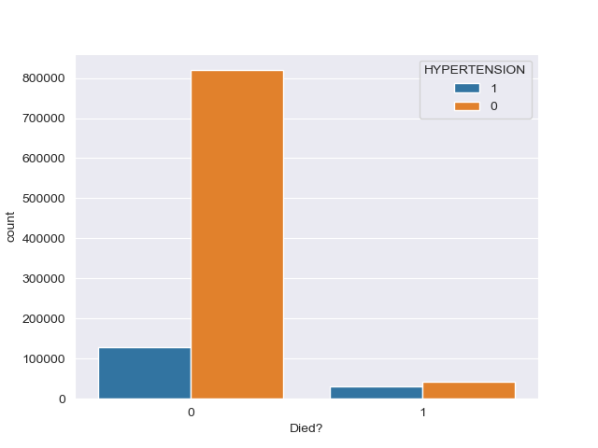
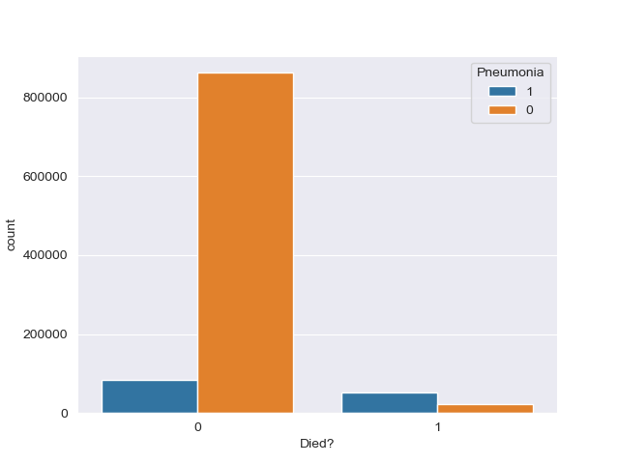
Data Exploration I

Slide 8
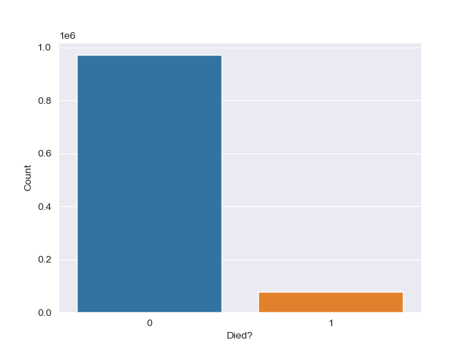
Data Exploration II
Class imbalance between patients who died (7%) and patients who did not (93%).
Most data was of binary type (yes or no) and only a few categorical.
Features ‘ICU’ and ‘INTUBED’ contained a large proportion of missing values.

Slide 9
Data Processing I
COVID is a virus that affects the respiratory system. It would make sense that people with pneumonia or COPD would be placed in the intensive care unit (ICU).
However, this was not the case as the separate correlations between these variables and ICU were low, other variables were not correlated well either.
No good correlations between INTUBED and any other variable.
ICU and INTUBED were decently correlated (0.3), however, values for both were missing in large proportions.
ICU and INTUBED features were removed entirely.

Slide 10
Data Processing II
Categorical features ‘CLASSIFICATION_FINAL’ and ‘MEDICAL_UNIT’ were one hot encoded.
Other features that contained missing values had samples removed, the missing value proportions were very small.

Slide 11
Modelling I
Target variable was binary and signified whether the patient died or not.
Initially, 3 test models were generated on a small sample. These were: K-Nearest Neighbours Random Forest Logistic Regression
The data was randomly under-sampled and scaled.
The most promising models were Logistic Regression and Random Forest.

Slide 12
Modelling II
Three variants of resampling were tested on both models: 1) Random under-sampling 2) Synthetic Minority Oversampling Technique (SMOTE) 3) Random under-sampling and SMOTE.
Additionally, as a form of experimentation, Principal Component Analysis (PCA) was tested on all the resampling variants for logistic regression.
In all cases, the data was split into a training sample (80%) and a testing sample (20%), stratifying the target to get equal distributions in each sample.

Slide 13
Modelling III
Standard z-score scaling was applied to data that was used for Logistic Regression models.
Grid searching was applied to the Random Forest models to select the best hyper-parameters.
Feature selection was applied to Logistic Regression models, based on Pearson correlation coefficients.

Slide 14
Modelling IV: Results
The top 3 models:
Model | Description | Train |  | Test
 |  | Precision | F1-Score | Precision | F1-Score
LR-S | Logistic regression z-scaled SMOTE over-sampled | 0.939 | 0.762 | 0.549 | 0.590
LR-US | Logistic regression z-scaled under-sampled and SMOTE over-sampled | 0.939 | 0.762 | 0.547 | 0.590
RF-US | Random forest under-sampled and SMOTE over-sampled | 0.943 | 0.774 | 0.549 | 0.591

Slide 15
Conclusion
The precision and f1-scores achieved were just better than a coin flip. The model is unsuccessful for the proposed purpose.
All of the trialled models displayed heavy over-fitting.

Slide 16
Limitations
Grid search in Random Forest was applied to ONLY a small sample of the dataset and a small range of values for parameters was used.
Trialling different parameters of the resampling methods could have been beneficial.
Choose a dataset that is linked to a scientific paper, explaining all features and conditions of sampling in detail.

